Slide 1



Student Database Grading
A grade calculator bot for automating grading process in school

Slide 2
Need for RPA
Many of the back-office tasks such as keeping student attendance, processing grades and report cards, are heavily paper-based, repetitive, and time-consuming, making them an ideal fit for RPA to automate these tasks.

Slide 3
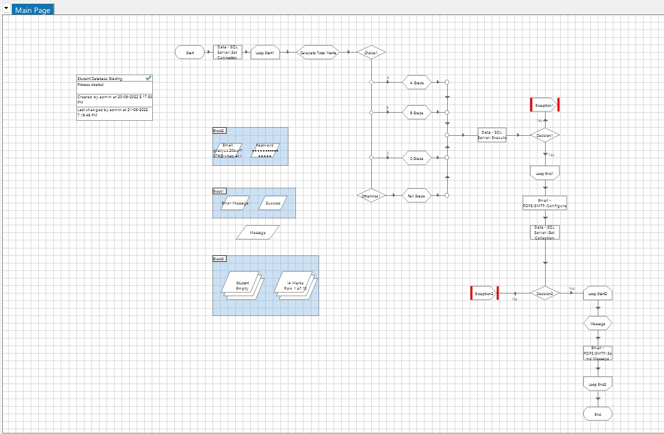
Tasks of the bot
Retrieve
Retrieve marks from database
Allocate
Allocate the grades and save it back to the Database
Send
Send the report through email to the Respective students

Slide 4
Process TIMELINE
1
2
3
4
5
6
7
8
SET DB SERVER
CALCULATE TOTAL MARKS
CALCULATE GRADES
SAVE THE GRADES TO DB
CONFIGURE MAIL
RETRIVE DATA FROM DB AS COLLECTION
WRITE MESSAGE
SEND REPORT THROUGH MAIL
Set connection with SQL server DATA SQL SERVER business object.
Calculate the total marks from the collection and find the Average
Assign Grades based on this average for all students in collection
Save this data after every grade to the respective FINAL IA table in the DB
Set connection to the respective email and ports
Retrieve data from many tables and form a collection out of the selective columns using SQL
Construct a personalized message out of this data from collection
Send this message to each student

Slide 5

Thank you
Pratyus Basuli
pratyus.20bcr7076@vitap.ac.in

